Slide 1
ELECTRONIC DEVICES
COURSE INSTRUCTOR:
UMANG RAJ PANDEY

Slide 2
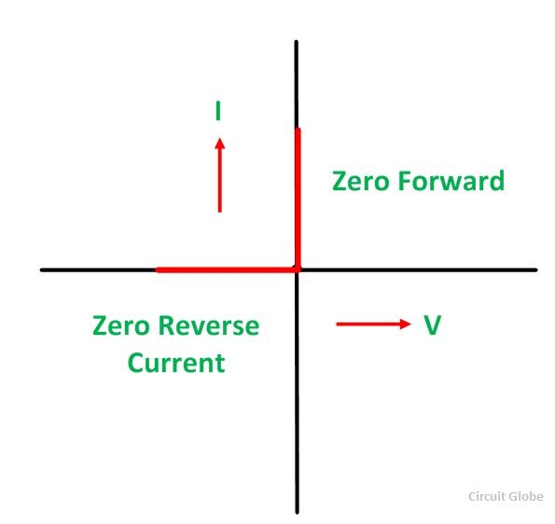
Volt-Ampere characteristics of PN junction diode
1.Ideal diode:

Slide 3
The diode that acts like perfect conductor when forward biased and acts like perfect insulator when reverse biased is called ideal diode.
It produces zero current when reverse biased and zero voltage drop when forward biased.
When diode is forward biased,it has zero resistance and when reverse biased it has infinite resistance.
Thus ideal diode acts as switch.The switch is closed(short circuited) when forward biased and opened when reverse biased.
Practically, no diode acts as ideal diode.

Slide 4
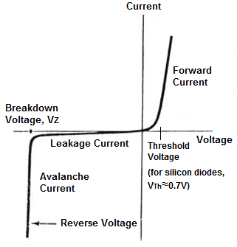
2.Real/Practical diode

Slide 5
An actual diode neither acts as perfect conductor when forward biased nor perfect insulator when reverse biased.
When the diode is forward biased, it will not conduct until potential barrier[0.7V for Si and 0.3V for Ge] at the junction is overcomed.
When the applied voltage exceeds potential barrier, diodes start conducting and small voltage drops across the internal resistance of diode or forward resistance of diode.

Slide 6
Thus the IV curve of PN diode is non linear.If reverse voltage exceeds certain value,junction breakdown may occur and immediately large current flows.
If forward biased voltage exceeds certain value, a large current will flow and diode may be damaged due to overheating.

Slide 7
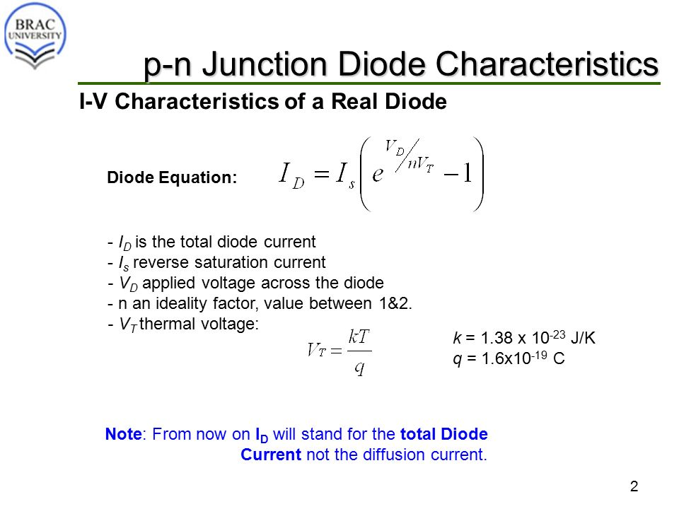

Slide 8

Q. At what voltage across silicon diode a 12 mA current flows at room temperature? Assume that leakage saturation current is 10 $µ A.$
Room temperature=27°C=300 K

Slide 9
Diode Resistance or Forward Resisitance
The resistance offered by diode in the circuit when forward biased is called diode resistance or forward resistance.
They are of two types:
a)DC or static resistance
b)AC or dynamic resistance

Slide 10
DC or static resistance
The resistance offered by the diode when connected to DC circuit is called DC or static resistance.
DC or static resistance is equal to V/I.
Its value depends on operating point on VI characteristics curve of diode.

Slide 11
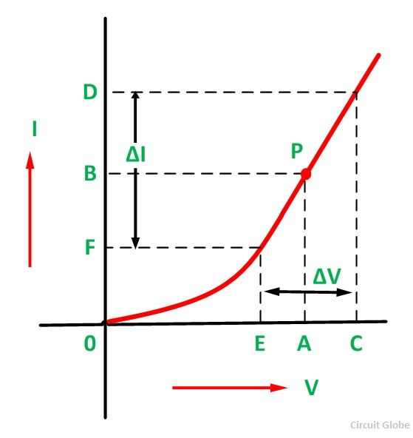
AC or dynamic resistance

Slide 12
